Slide 1
Invoice
Work Order Creation
Schedule
Dispatch
Service
Review / Approval
Inventory Adjustments

Slide 2
Work Order Creation
Work Order Creation
Schedule
Dispatch
Service
Review / Approval
Invoice &
Inventory Adjustments
What Happens | New work order created Assigned incidents, products, services, etc.
Who Performs | Agreement: Auto generated on a recurring basis Case: By customer support Opportunity: By sales/scheduling Manual: By field agent, or centralized dispatch
Work Order Status | Open - unscheduled
Booking Status | N/A

Slide 3
Scheduling Work Orders
Work Order Creation
Schedule
Dispatch
Service
Review / Approval
Invoice &
Inventory Adjustments
What Happens | Work order schedule created Resources assigned to the work order Date and time specified
Who Performs | Dispatcher (manually) Field Agent (manually or mobile) Dispatcher with help of scheduling assistant Routing engine
Work Order Status | Open - scheduled
Booking Status | Scheduled

Slide 4
Dispatching Work Orders
Work Order Creation
Schedule
Dispatch
Service
Review / Approval
Invoice &
Inventory Adjustments
What Happens | Field agent notified of work order Optional: Field agent reviews and accepts / declines the work order
Who Performs | Notification sent by system to field agent, customer, or others. (Notifications need to be setup)
Work Order Status | Open – scheduled
Booking Status | Scheduled (Custom Status)

Slide 5
Service Delivery
Work Order Creation
Schedule
Dispatch
Service
Review / Approval
Invoice &
Inventory Adjustments
What Happens | Work order carried out Information about what is performed is entered through the mobile app.
Who Performs | Field Agent
Work Order Status | Open – In Progress > Open - Completed
Booking Status | Traveling In Progress Completed

Slide 6
Review / Approval
Work Order Creation
Schedule
Dispatch
Service
Review / Approval
Invoice &
Inventory Adjustments
What Happens | Supervisor verifies that all work was done properly, and all information on the work order is correct.
Who Performs | Supervisor/Manager Back office accounting
Work Order Status | Open – Completed > Closed-Posted
Booking Status | Completed

Slide 7
Invoicing and Inventory Adjustments
Work Order Creation
Schedule
Dispatch
Service
Review / Approval
Invoice &
Inventory Adjustments
What Happens | Invoice is created based on products and services used. Inventory adjustments made. Products converted into equipment. (If applicable)
Who Performs | Automatically sent by system
Work Order Status | Closed - Posted
Booking Status | Completed

Slide 8
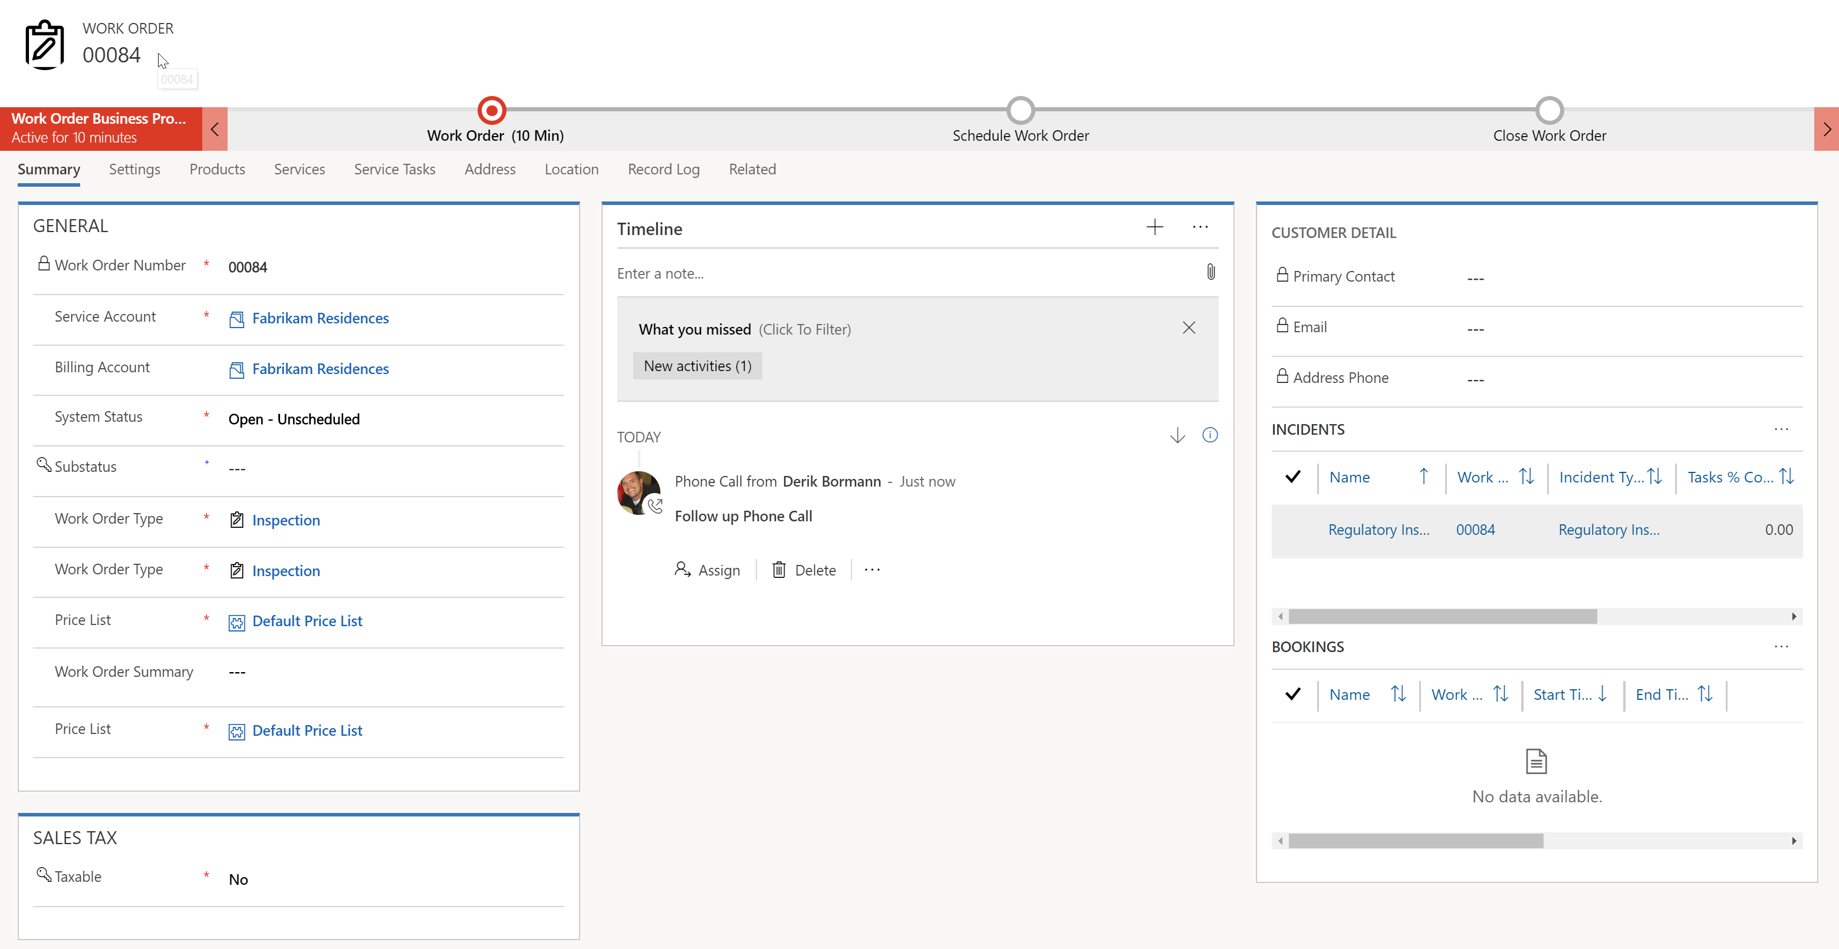

Provides access to items attached to the work order such products, services, and tasks.
Sub statuses can be added to act as triggers to indicate to dispatch that an Item is ready to schedule.
Work Orders that are scheduled will display any bookings associated with them.

Slide 9
Work Order Related Records
Billing Account
Incident
Service Account
Work Order Type
Product
Priority
Work Order
Service
Service Territory
Service Task
Resource Booking
Characteristics
Resource Requirement

Slide 10
How Scheduling Works
Work Order Created
Resource Requirement Record Defined
Resource Booking Created

Slide 11
Work Order Lifecycle Statuses
Work Order Status
Open – Completed
Work Order Created
Work Order Status
Open - Unscheduled
Work Order Status
Open - Scheduled
Work Order Status
Open – In Progress
Resource Requirement Record Created
Bookable Resource Booking Created:
Status = Scheduled
Bookable Resource Booking
Status = In Progress
Bookable Resource Booking
Status = Completed
Item Scheduled

Slide 12
Lawn Care Agreement
Booking Setup
Invoice Setup
Weekly Lawn Care
Monthly Landscaping
Monthly Invoice
Quarterly Lawn Treatments

Slide 13
Agreement
Booking Setup
Invoice Setup
Weekly Lawn Care
Monthly Landscaping
Monthly Invoice
Quartly Lawn Treatments

Slide 14
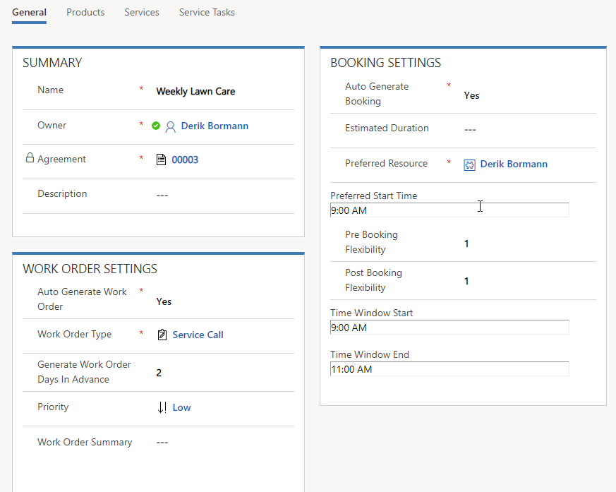
When setting auto generate booking to yes, you must supply a preferred resource and start time.

Slide 15
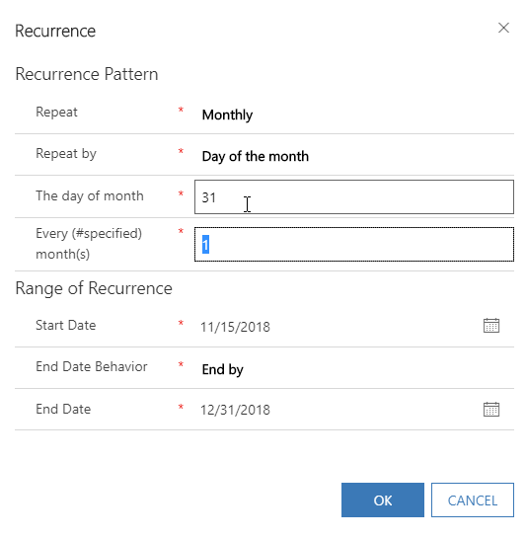

Slide 16
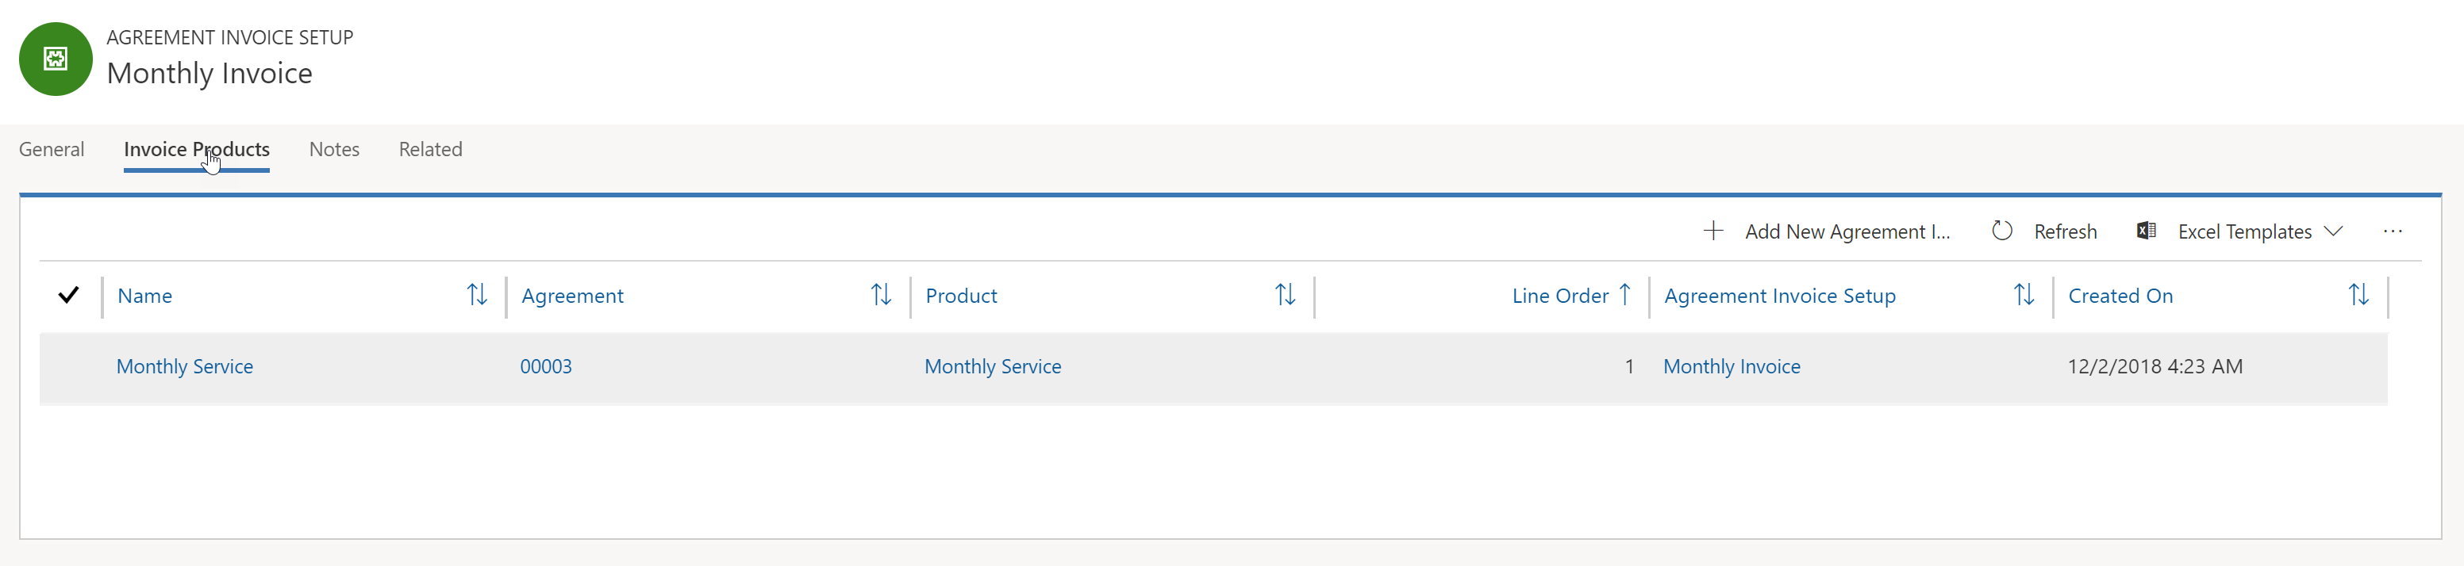

Slide 17
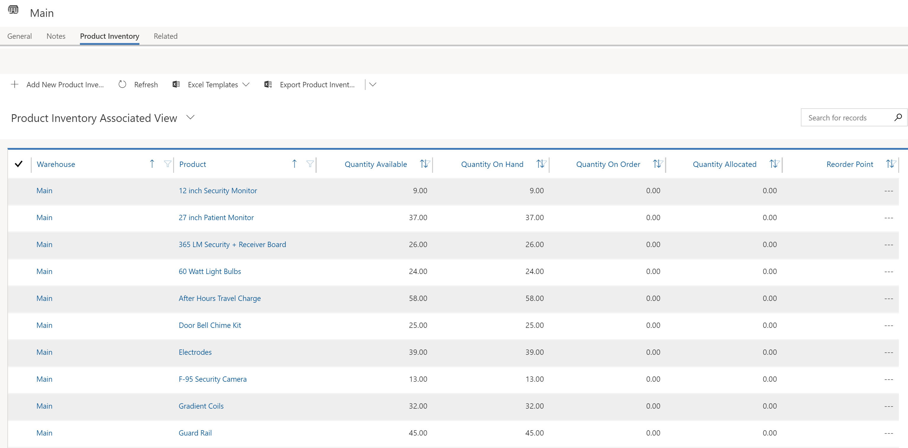

Slide 18
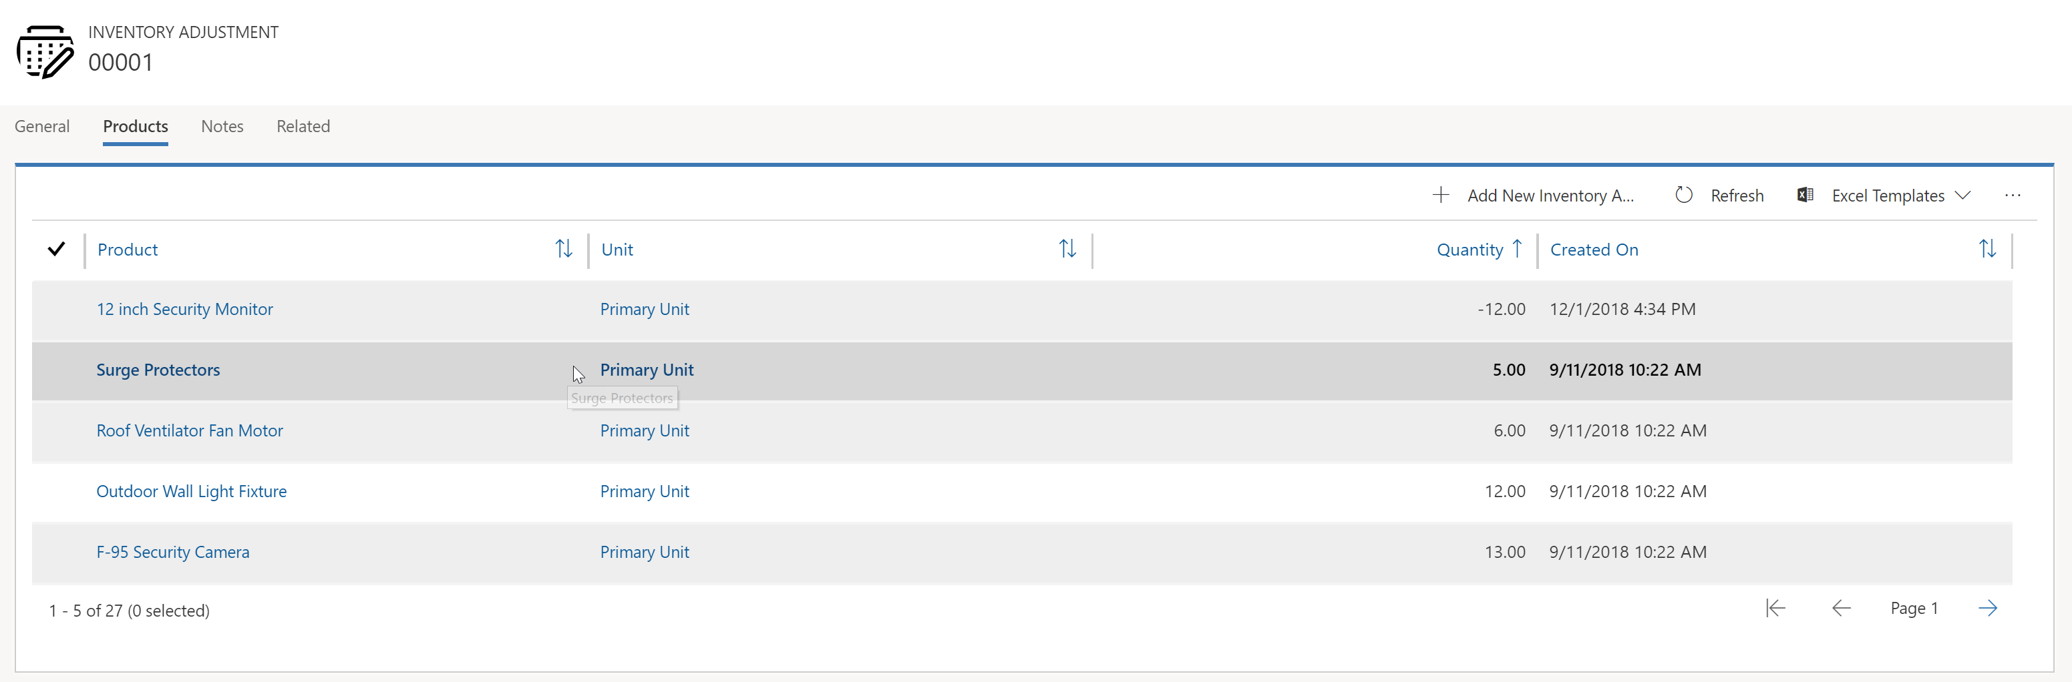
Inventory reductions are defined by adding a negative amount to the quantity.

Slide 19
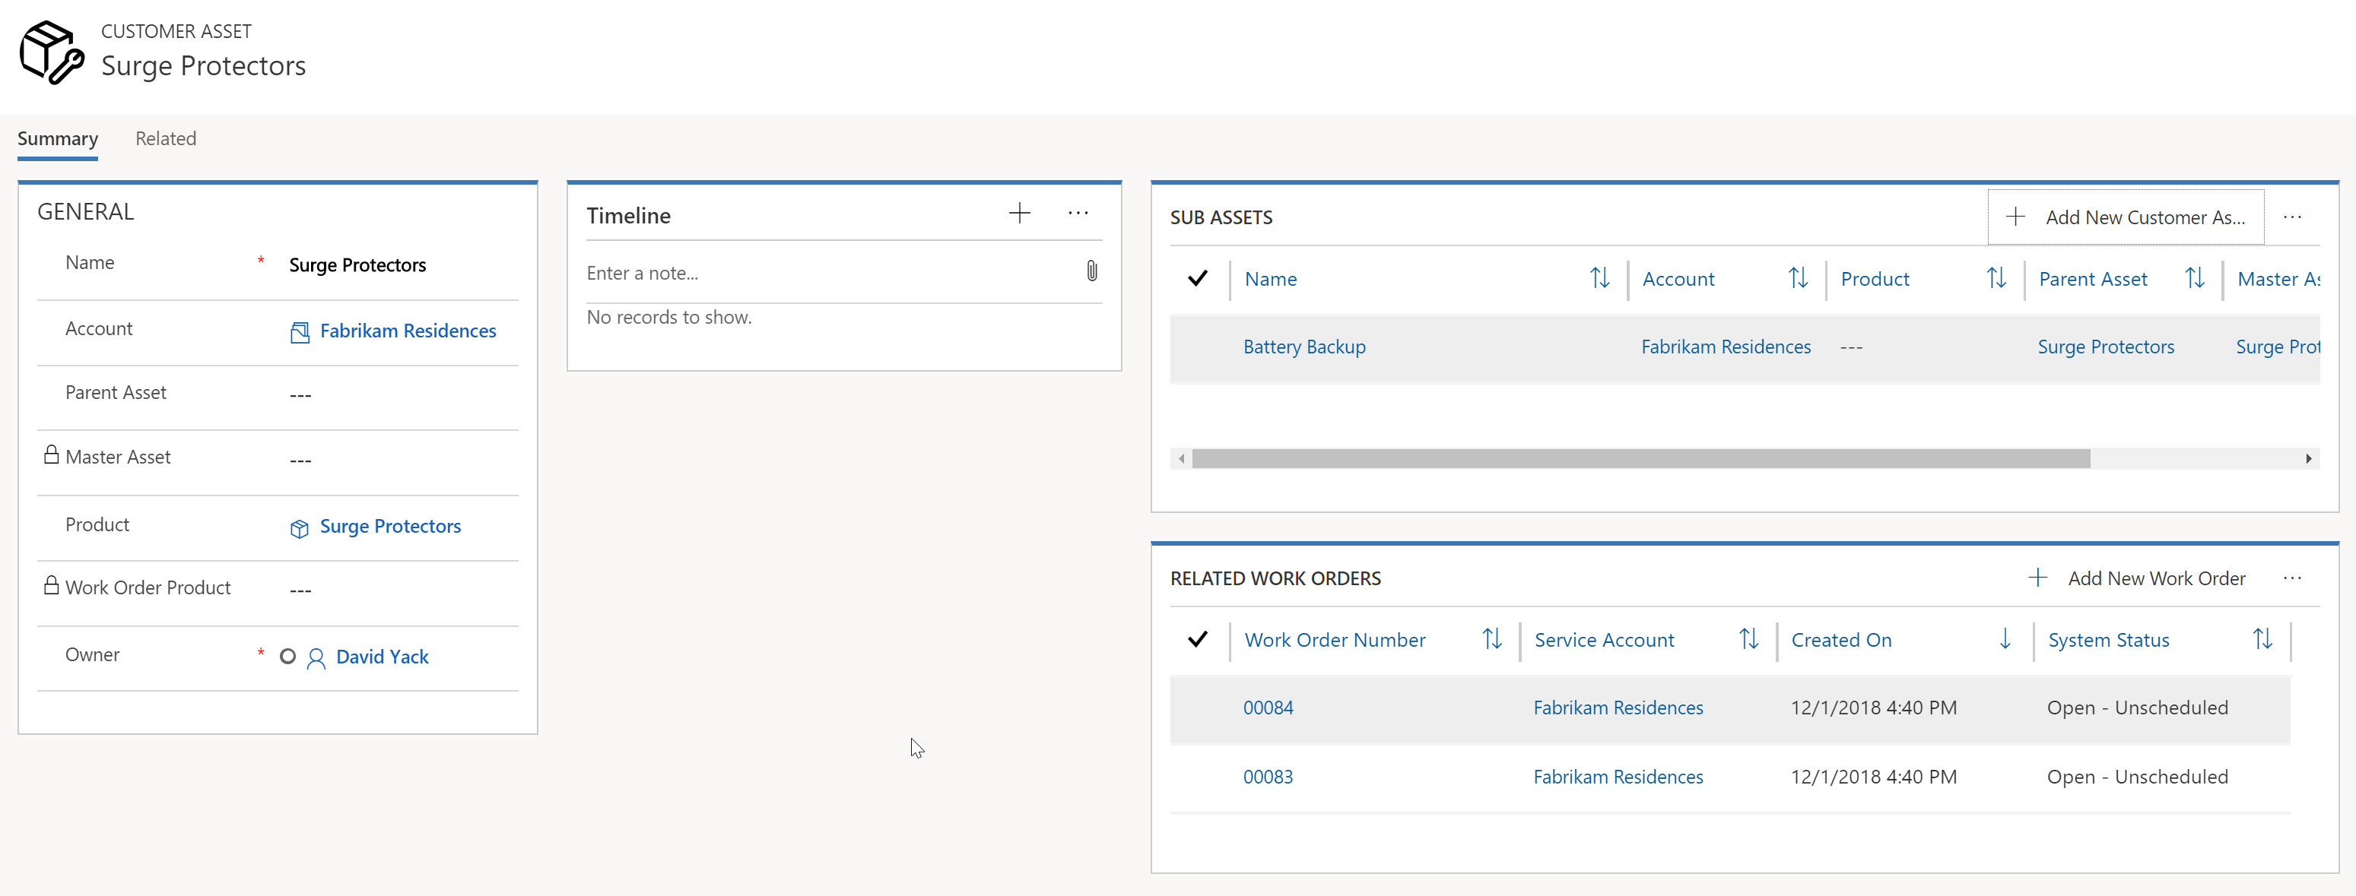
Sub assets can be added to for related sub components like IoT sensors located in an IoT appliance.
Work Orders associated with the asset and their status will be shown here.

